Slide 1
Fabric Complex Processes Monitor V1 Implementation
a.k.a “Migration Monitor”

Slide 2
Contents
How it works
Package contents
Implementation Steps

Slide 3
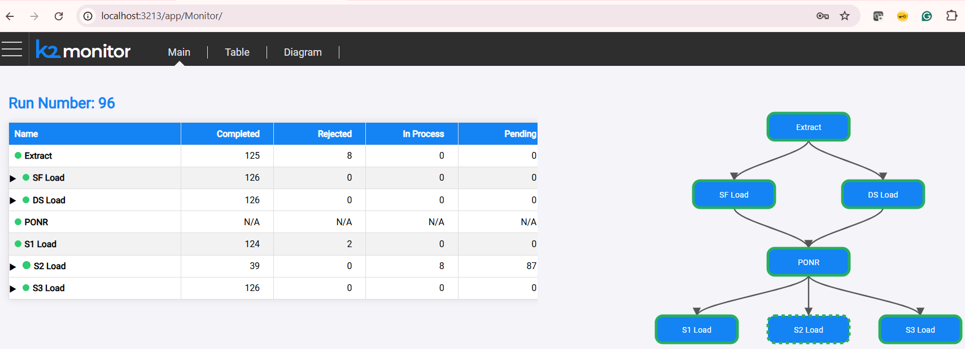
How It Works – Overview
The Process Monitor is a web app integrated with the Fabric web framework.
The process stages table and flow diagram is derived from configuration
Mtable, and status updates are received via web-services.

Slide 4
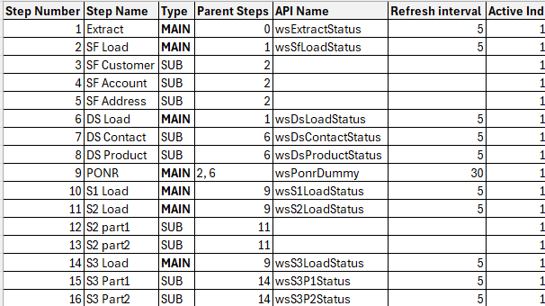
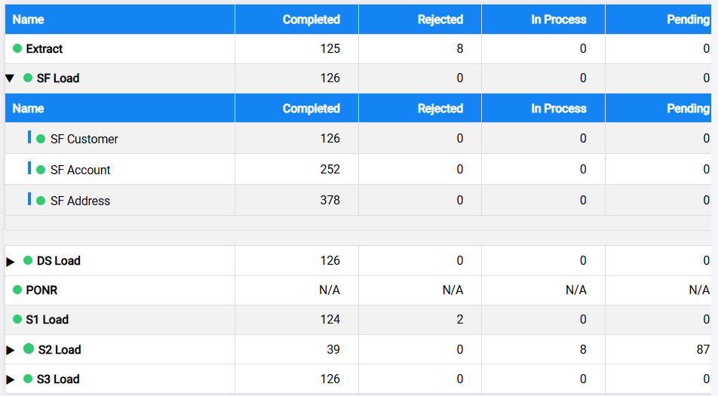
How It Works
The configuration MTable is filled as part of the project implementation.
The monitor gets the configuration contents and draws the monitor page.
Each step status and numbers of objects in pending/in-process/rejected/completed states is retrieved by calling the API specified in the configuration MTable:

Slide 5
Package Contents (part 1)
The Monitor K2Export file contains the following items:
Monitor LU
MTables –
mtMonitorConfig – main monitor configuration MTable
mtMonitorBatchStatus – optional MTable, translating the results of a batch-status to the monitor expected status – for use in the implementation if/when required.
Web Services
Java file monitor/Logic.java – containing Monitor WS framework:
wsMonitorConfig – returns the contents of mtMonitorConfig
wsExecId – place-holder for mandatory WS; must be implemented by as part of the project implementation
wsProcStatusExample – dummy WS, providing Hard-coded example of the data that a process-status WS should return
These items should be imported into any project that wishes to use the monitor.

Slide 6
Package Contents (continued)
The Monitor LU also contains a “web/monitor” folder which does not appear on the Studio.
The files in this folder include the implementation of the monitor:
Index.html
style.css
style2.css
table5.html
table6.html
These items should be imported into any project that wishes to use the monitor.

Slide 7
Implementation Steps (part 1 – high-level)
To implement the monitor in a Fabric project, follow these steps:
Import into the Project all the items specified in the “Package Contents” section of this document from the Monitor_v1.k2export
On the Fabric server “apps.json” file, add the Monitor application
Fill mtMonitorConfig and create the related WSs according to the project needs

Slide 8
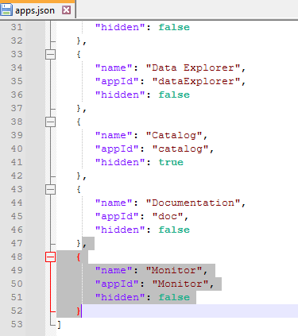
Implementation Steps (part 2 – apps.json)
Add additional entry for the “Monitor” application in the apps.json file.
File location is typically:
Windows: C:\K2View\Fabric_8.1\Server\fabric\staticWeb
Linux: ${K2_HOME}/fabric/staticWeb
The JSON section to be added is:
{ "name": "Monitor",
"appId": "Monitor",
"hidden": false
}

Slide 9
Implementation Steps (part 3.1 – config MTable)
Fill the mtMonitorConfig Mtable with the steps of the process:
Step Number – Identification number of the step (Recommended: start with 1 and increase sequentially)
Step Name – name of the step as it should appear on the monitor
Type – Specify if the step is a “main process” or a “Sub-process”:
MAIN – step is a main process
SUB – step is a sub-process
Parent Steps – indicates the parent(s) of a step.
For MAIN step, points to the previous main step(s).
For the 1st main process, the “Parent Steps” should be 0 (zero).
For SUB step, points to the parent MAIN step
API Name – name of the API that will be called to get the step status.
These APIs must be implemented in the project
A SUB step may not have API name; in such case, the monitor expects the parent step API to return the status of the MAIN step and all it’s SUB steps.
Refresh Interval – number of seconds between refreshes of the data
Active Ind – “1” (active) / “0” (inactive) indicator,
“Inactive” steps are not presented on the monitor (not the execution)

Slide 10
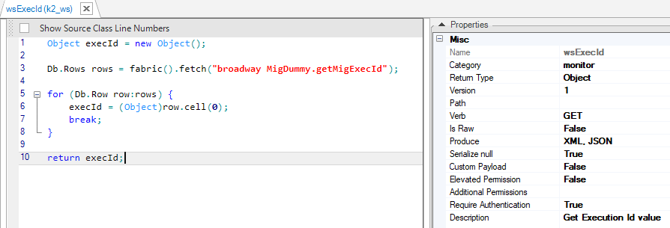
Implementation Steps (part 3.2 – wsExecId)
wsExecId is a Web-Service that should return the current run Id.
The run-Id returned by this WS is presented on the monitor.
It is also passed as parameter when calling the various step status WSs listed in mtMonitorConfig.
The WS gets no parameters.
It should support at least the GET verb, and return a JSON object, on this format:
{"execId": “<value>"}
For example:
{"execId": "96"}

Slide 11
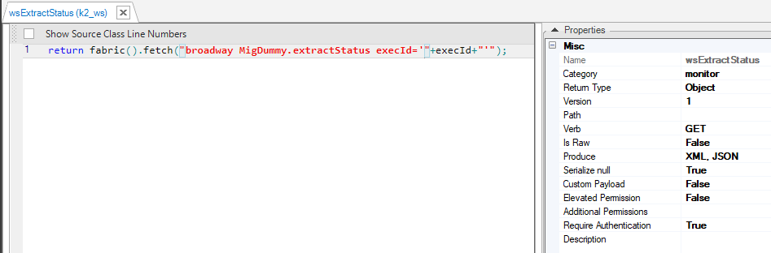
Implementation Steps (part 3.3 – Step Status WSs)
Each WS (API) listed in mtMonitorConfig must be implemented.
The WS gets one input parameter, “execId”, of type string.
It should support at least the GET verb, and return a JSON object, on this format:
{
"name": "<step name>", à the name of the step or sub-step, matching the "step name" column in the configuration table
"status" : "<step status>",à the step process status: "pending", "running", "failed", "completed"
"completed": "<completed objects count>",à count of the objects already completed by the process
"rejected": "<rejected objects count>",à count of the objects rejected by the process
"in process": "<in-process objects count>",à count of objects currently in-process
"pending": "<pending objects count>",à count of the objects still pending to be processed
"subProcesses": [ à an array of the sub-processes included in the process (optional)
"name": "<step name>", à the name of the sub-step, matching the "step name" column in the configuration table
"status": "<step status>", à the sub-step process status: "pending", "running", "failed", "completed"
"completed": "<completed objects count>", à count of the objects already completed by the process
"rejected": "< rejected objects count >", à count of the objects rejected by the process
"in process": "< in-process objects count >", à count of objects currently in-process
"pending": "< pending objects count >", à count of the objects still pending to be processed
]
}
If a WS is specified for a SUB-step, it should not include the “subProcesses” section
If WSs are not specified for SUB-steps, the parent MAIN-step WS must include the “subProcesses” section, with an entry for each SUB-step

